Slide 1
HOW TO APPLY FOR RECOGNITION OF THE PREGRADUATION PRACTICE ABROAD IN THE IS
GUIDE

Slide 2
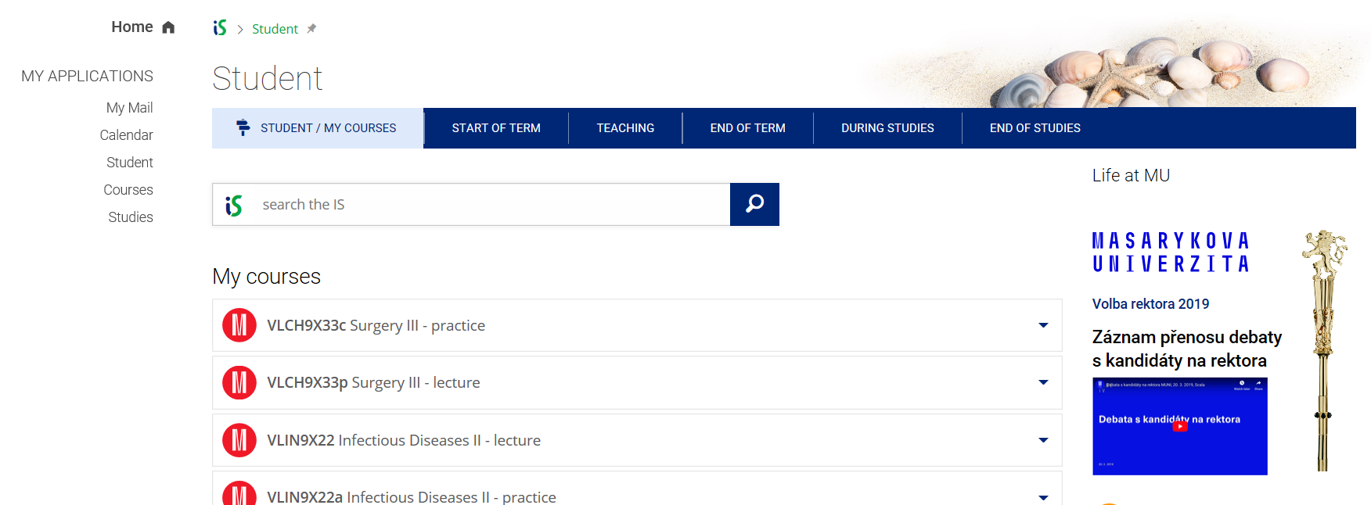
1) OPEN YOUR IS STUDENT ACCOUNT AND CLICK ON THE TAB DURING STUDIES
2) CHOOSE INTERNSHIPS AND STAYS

Slide 3
3) CHOOSE A RELEVANT RECORD OF THE STAY ABROAD AND TICK IT
4) THEN CHOOSE AN EDIT SELECTED BUTTON TO CONTINUE

Slide 4
6) PLEASE CHECK THAT YOU HAVE CHOSEN THE RIGHT ADMINISTRATOR
5) PLEASE CHECK WHETHER THE DATES OF THE STAY ABROAD YOU ENTERED BEFORE ARE THE SAME AS THE DATES ON THE CONFIRMATION OF PLACEMENT PERIOD DOCUMENT (if the dates differ, you have to correct dates according to the confirmation of placement period)

Slide 5
7) CHECK WHETHER YOU UPLOADED ALL THE RELEVANT DOCUMENTS - TRAINING AGREEMENT - CONFIRMATION OF PLACEMENT PERIOD - TRANSCRIPT OF RECORDS (a document with required procedures); THE DOCUMENTS MUST BE SIGNED BY YOU, FOREIGN INSTITUTION AND HOME INSTITUTION AS WELL AS STAMPED.
8) THEN CLICK ON ENTER A COURSE

Slide 6
NOW YOU HAVE TO CREATE A COURSE THAT REPRESENTS THE TRAINEESHIP YOU DID ABROAD
9) COMPLETE THE BOX WITH A NAME OF THE TRAINEESHIP AND CLICK ON DOHLEDAT BUTTON
SUGGESTIONS FOR TRAINEESHIPS NAMES:
Pediatrics Traineeship / Training / Internship
Surgery Traineeship / Training / Internship, ect.

Slide 7
HERE YOU CAN SEE COURSES THAT WERE CREATED BY STUDENTS BEFORE; YOU CAN USE ONE OF THEM IF THE PLACE OF THE TRAINEESHIP AGREES WITH YOUR PLACE; YOU WILL TICK THE COURSE AND COMPLETE HODNOCENÍ WITH Z AND CLICK ON ULOŽIT BUTTON
IN CASE YOU THE COURSES ARE NOT SUITABLE FOR YOU, CLINK ON THE LINK
PŘEDMĚT NELZE DOHLEDAT NEBO MÁ JINÝ POČET KREDITŮ, ZALOŽÍM NOVÝ

Slide 8
Complete the boxes (1-6) with relevant information: 1) name of the internship in its original language 2) name of the internship in English 3) number of credits (the same as our pregraduation practice for which the internship will be recognized* 4) a way of completion* 5) evaluation* 6) language of the internship Then click on ULOŽIT button
1)
2)
3)
6)
4)
5)
*Note: how to complete the boxes 3, 4, and 5
PEDIATRICS: 8 - z - Z
INTERNAL MEDICINE: 18 - z – Z
SURGERY: 14 - z - Z
PALIATIVE MEDICINE 2 - z - Z
GENERAL MEDICAL PRACTICE, GERIATRICS 12 - z – Z
3 – k – P
(you have to create 2 internships with different names, numbers of credits and a way of completion as there are two different courses in our curriculum that have to be recognized)

Slide 9
The IS is never happy with what you do ☺. So please click on SKUTEČNĚ ULOŽIT button.

Slide 10
Now your internships are established in the IS. So you can go back to the record of your internship. Click on EVIDENCE ÚDAJŮ O STÁŽÍCH, STUDIJNÍCH A PRACOVNÍCH POBYTECH

Slide 11
Now you can see the internship you created in the record .
It is time to submit the application for the recognition.

Slide 12
Tick the course you want to get recognized. Do not care about the period; Marketa can change that when dealing with the recognition request. And click on CONTINUE TO SUBMIT THE REQUEST

Slide 13
Complete this box with a code of the pregraduation practice you want to get recognized and click on FIND COURSE. Pediatrics aVLPD11Xpp Surgery aVLCH11Xpp Internal Medicine aVLVL11Xpp Gen. Med. Practice, Geriatrics aVLPL11Xpp Paliative Medicine aVLPP11Xpp

Slide 14
The IS finds the course; tick it and scroll down.

Slide 15
Submit the request for recognition.

Slide 16
If you want to overview all your requests, click on OVERVIEW OF ALL MY REQUESTS
Now your request is done. The IS will send a message to Marketa to deal with it.
If you want to submit another request for recognition, click on BACK TO COURSE SELECTION

